Slide 1
Morphology
Morphology -“shape” feature
Morphology relates to the “shape” of a connected component
Morphological operations modify the shape of a component or give information about the shape of a component
  erosion/dilation (expand or shrink a component)
  opening/closing (eliminate “boundary” noise)
  thinning (determining the “skeletal structure”)
  convex hulls (determining the boundary)

Slide 2
Structuring Elements
1 | 1 | 1
1 | 1 | 1
1 | 1 | 1
0 | 1 | 0
1 | 1 | 1
0 | 1 | 0
Square-size structuring element
Cross-size structuring element

Slide 3
Fitting and Hitting
Fitting: A structuring element is said to fit an image if, for each of its pixels that is set to 1, the corresponding image pixel is also 1.
Hitting: A structuring element is said to intersect or hit, an image if, for any of its pixels that is set to 1, the corresponding image pixel is also 1.
In both cases, we ignore image pixels for which the corresponding structuring element pixel is 0.

Slide 4
Dilation
Used to increase the area of a component.
  Adds pixels around the boundaries
  fills interior holes
An image is processed by applying a structuring element
  center the structuring element S on pixel P
  if P is OFF then set it to ON if any part of S overlaps an ON image pixel
This process can only turn pixels from OFF to ON
The component can only grow

Slide 5
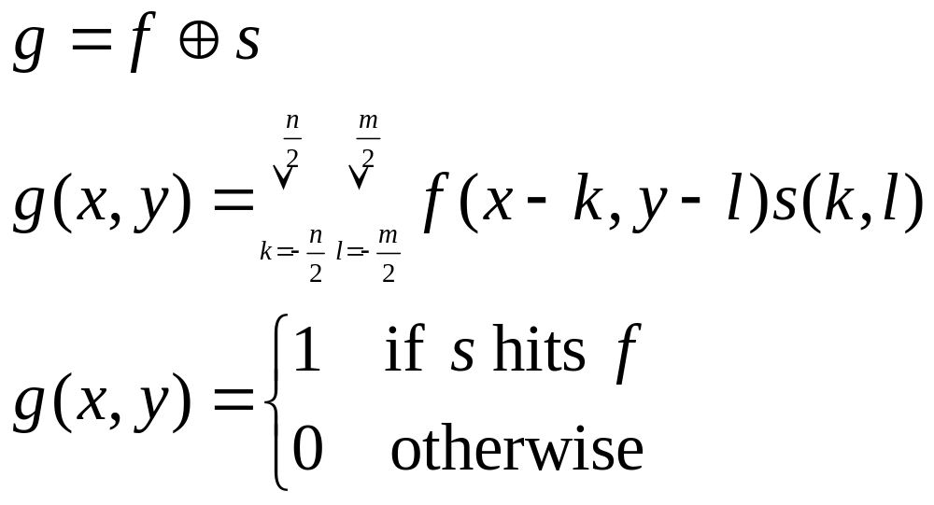
Dilation
Given binary image f and structuring element s the dilated image g can be described as:

Slide 6
Dilation
0 | 0 | 0 | 0 | 0 | 0 | 0
0 | 1 | 1 | 0 | 0 | 0 | 1
0 | 1 | 0 | 0 | 0 | 0 | 1
0 | 1 | 0 | 0 | 0 | 0 | 1
0 | 1 | 1 | 1 | 1 | 1 | 1
0 | 0 | 0 | 1 | 1 | 1 | 0
0 | 0 | 0 | 0 | 0 | 0 | 0
1 | 1 | 1 | 1 | 0 | 1 | 1
1 | 1 | 1 | 1 | 0 | 1 | 1
1 | 1 | 1 | 1 | 0 | 1 | 1
1 | 1 | 1 | 1 | 1 | 1 | 1
1 | 1 | 1 | 1 | 1 | 1 | 1
1 | 1 | 1 | 1 | 1 | 1 | 1
0 | 0 | 1 | 1 | 1 | 1 | 1
1 | 1 | 1
1 | 1 | 1
1 | 1 | 1
Square-size structuring element

Slide 7
Dilation
0 | 0 | 0 | 0 | 0 | 0 | 0
0 | 1 | 1 | 0 | 0 | 0 | 1
0 | 1 | 0 | 0 | 0 | 0 | 1
0 | 1 | 0 | 0 | 0 | 0 | 1
0 | 1 | 1 | 1 | 1 | 1 | 1
0 | 0 | 0 | 1 | 1 | 1 | 0
0 | 0 | 0 | 0 | 0 | 0 | 0
0 | 1 | 1 | 0 | 0 | 0 | 1
1 | 1 | 1 | 1 | 0 | 1 | 1
1 | 1 | 1 | 0 | 0 | 1 | 1
1 | 1 | 1 | 1 | 1 | 1 | 1
1 | 1 | 1 | 1 | 1 | 1 | 1
0 | 1 | 1 | 1 | 1 | 1 | 1
0 | 0 | 0 | 1 | 1 | 1 | 0
0 | 1 | 0
1 | 1 | 1
0 | 1 | 0
Cross-size structuring element

Slide 8
Erosion
Used to decrease the area of a component.
  Removes pixels around the boundaries
  Enlarges interior holes
An image is processed by applying a structuring element
  center the structuring element S on pixel P
  if P is ON then set it to OFF if any part of S overlaps an OFF image pixel
This process can only turn pixels from ON to OFF
The component can only shrink

Slide 9
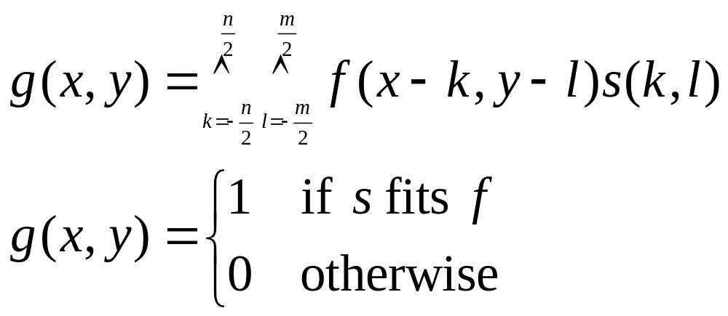
Erosion
Given binary image f and structuring element s the dilated image g can be described as:
g = f  s

Slide 10
Erosion
0 | 1 | 1 | 0 | 0 | 0 | 1
1 | 1 | 1 | 1 | 0 | 1 | 1
1 | 1 | 1 | 0 | 0 | 1 | 1
1 | 1 | 1 | 1 | 1 | 1 | 1
1 | 1 | 1 | 1 | 1 | 1 | 1
0 | 1 | 1 | 1 | 1 | 1 | 1
0 | 0 | 0 | 1 | 1 | 1 | 0
0 | 0 | 0 | 0 | 0 | 0 | 0
0 | 0 | 0 | 0 | 0 | 0 | 0
0 | 1 | 0 | 0 | 0 | 0 | 0
0 | 1 | 0 | 0 | 0 | 0 | 0
0 | 0 | 1 | 1 | 1 | 1 | 0
0 | 0 | 0 | 0 | 1 | 0 | 0
0 | 0 | 0 | 0 | 0 | 0 | 0
1 | 1 | 1
1 | 1 | 1
1 | 1 | 1
Square-size structuring element

Slide 11
Opening and Closing Operations
The open operation is defined as a dilation followed by an erosion
  smoothens boundaries
  enlarges narrow gaps
  eliminates “spikes”
The close operation is defined as an erosion followed by a dilation
  fills narrow gaps
  eliminates small holes and breaks
Repeated applications of either “open” or “close” have no effect

Slide 12
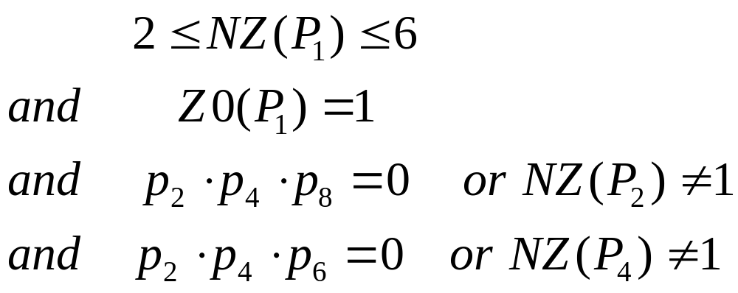
Thinning Algorithms
Thinning transform an object to a set of simple digital arcs, which lie roughly along their medial axes.
Let Z0(P₁) be the number of zero to nonzero transitions in the ordered set p₂, p₃, p₄, …,P₉,P₂. Let NZ(P₁) be the number of nonzero neighbors of P₁. Then P₁ is deleted if
The procedure is repeated until no further changes occur in the image.

